Slide 1
RESUME CLASSIFICATION
GROUP 1
P266

Slide 2
GROUP MEMBERS
Mr. Gaurav Kailash Deshmukh
Mr. Himanshu Sanjay Patil
Mr. Gurjeet Singh Subhash Punjabi
Mr. Pratik Shashikant Tarale
Mr. Pratik Kishor Taori
Mr. Umang Gopal Mantri
Ms. Shruti Rajendra Panaskar

Slide 3
OBJECTIVE
The major objective of our system is to take the current resume ranking system to other level and makes it more flexible for both the entity,
1) Candidates, who has been hired.
2) Client company, who is hiring the candidates.

Slide 4
PROJECT FLOW
01 02 03
Data Extraction Exploratory Data Analysis Visualization
[EDA]
04 05 06
Feature Extraction & Model Evaluation Model Deployment
Model Building

Slide 5
01
Data Extraction

Slide 6
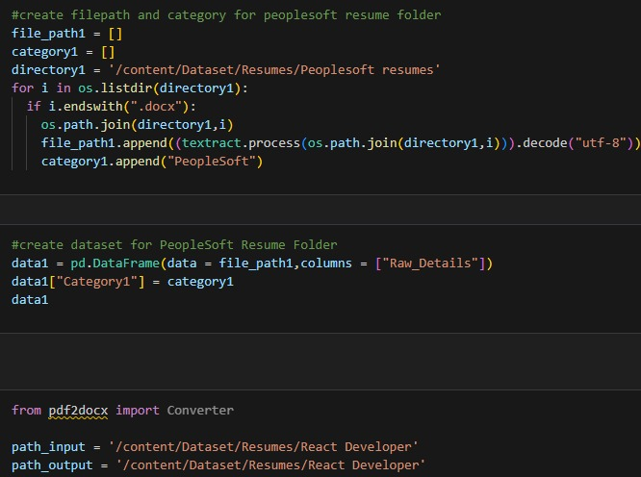
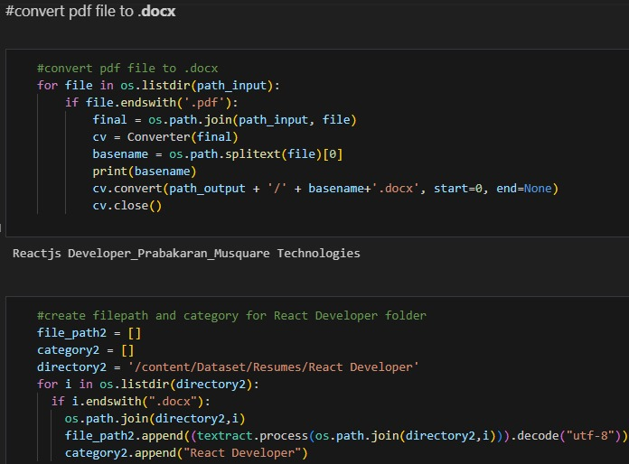
EXTRACT TEXT FROM DATASET
Here we extracted the text from data
Covert pdf file to docx

Slide 7
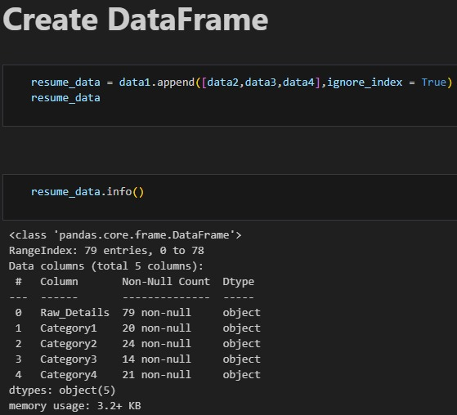
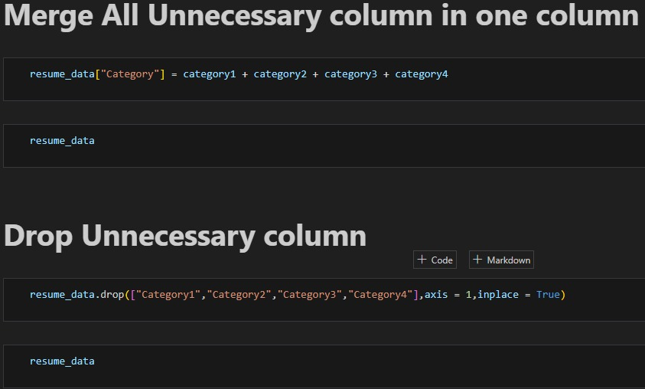
DATA FRAME
Create Data Frame
Merge & Drop Columns

Slide 8
02
Exploratory Data Analysis

Slide 9
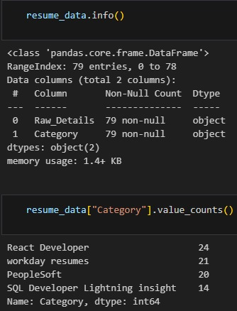
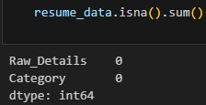
EXPLORATORY DATA ANALYSIS [EDA]

Slide 10
03
Visualization

Slide 11
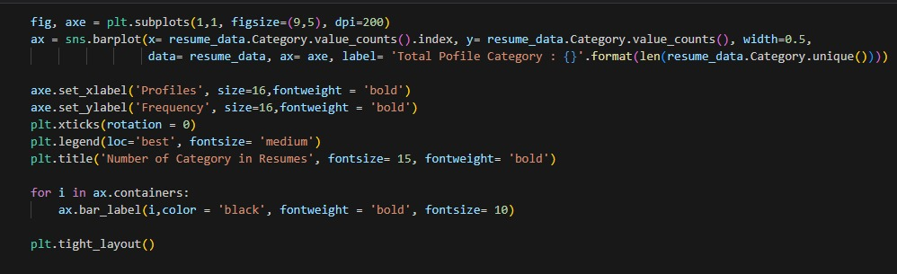
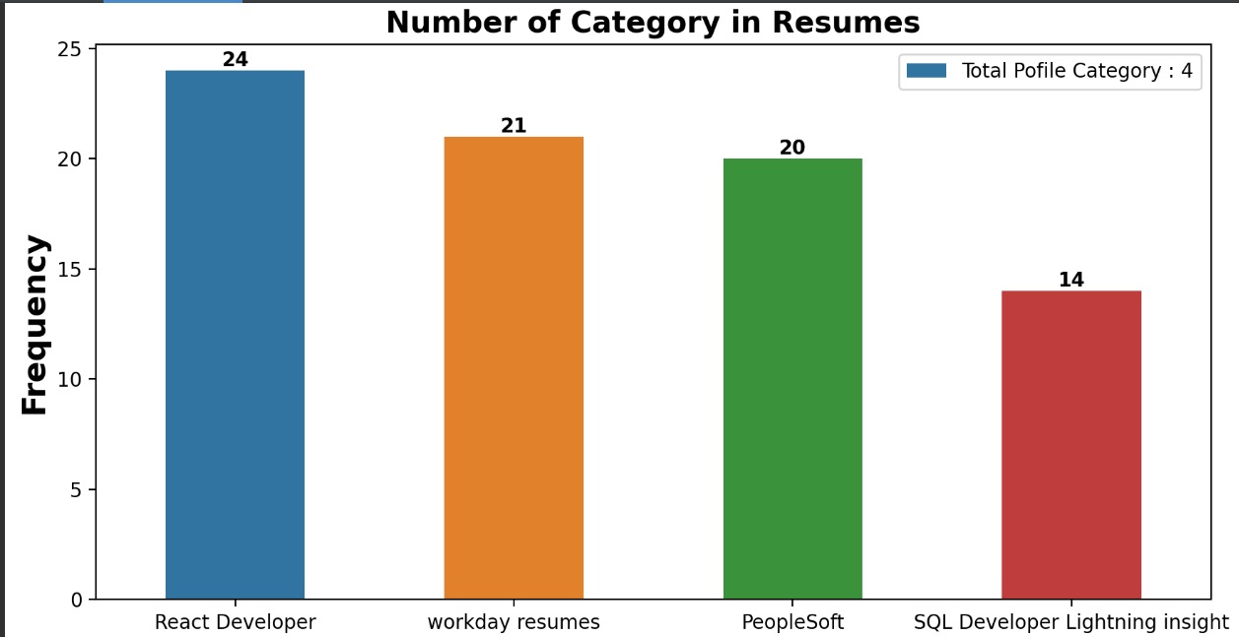
BAR PLOT

Slide 12
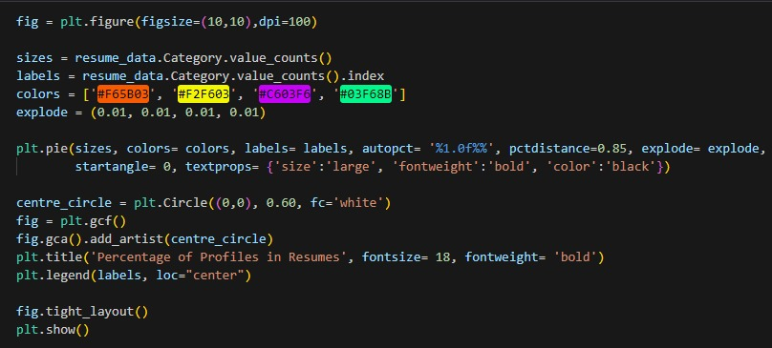
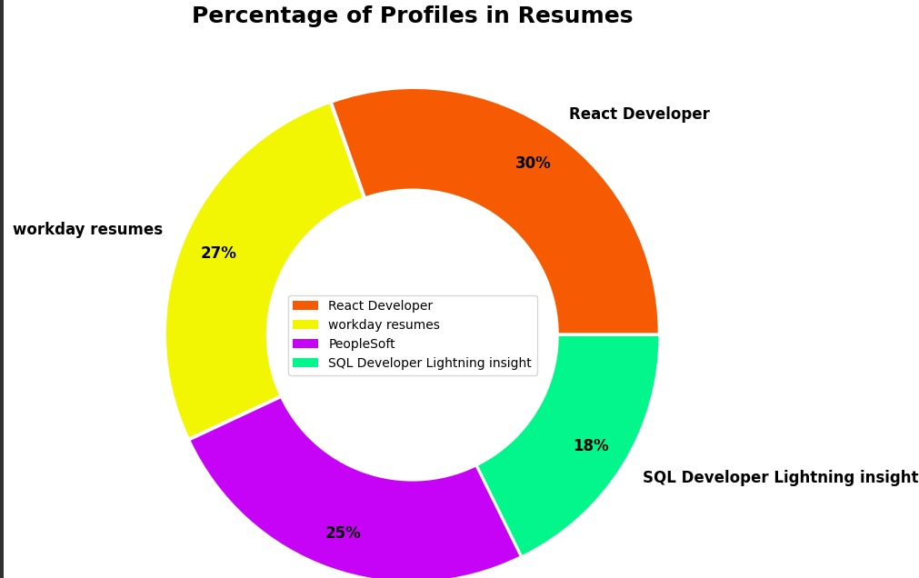
PERCENTAGE OF CATEGORY BY USING PIE GRAPH

Slide 13
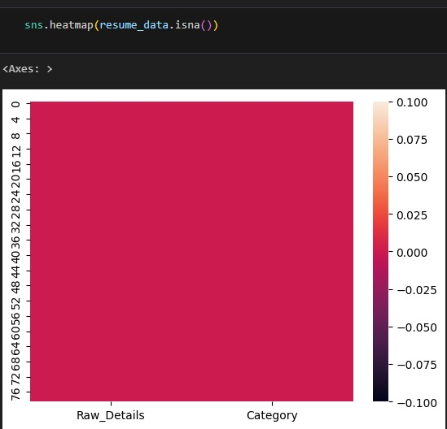
HEATMAP

Slide 14
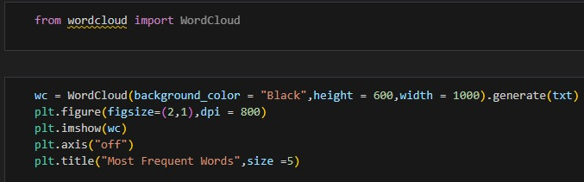
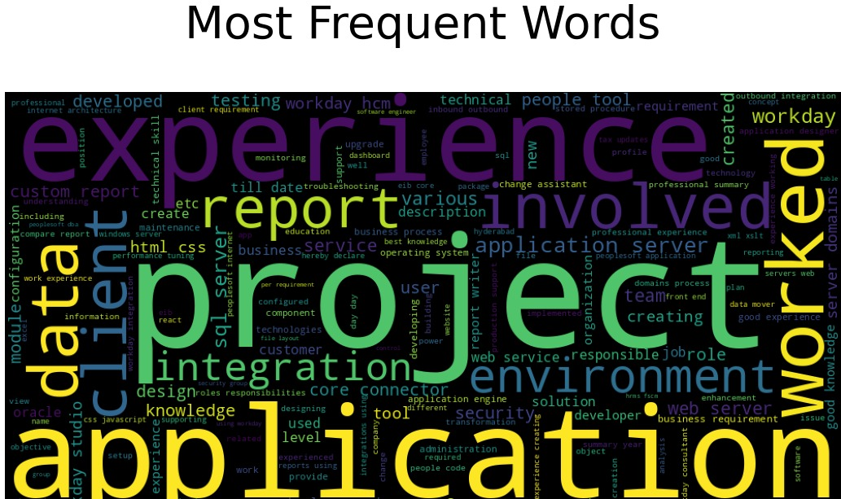
WORD CLOUD

Slide 15
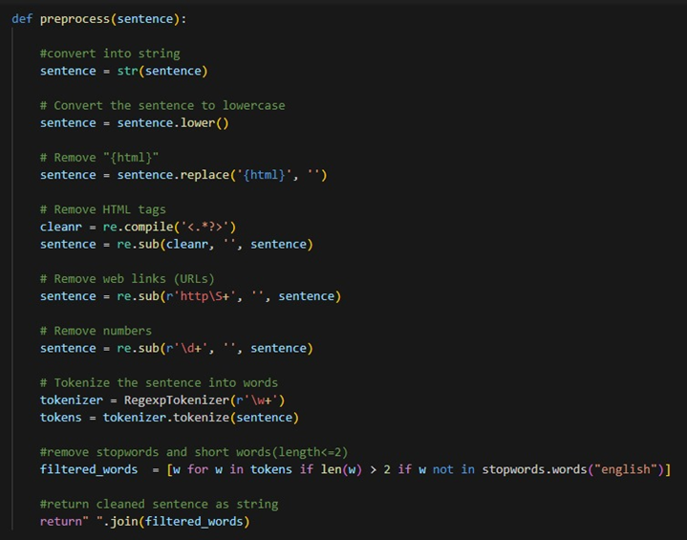
DATA CLEANING

Slide 16
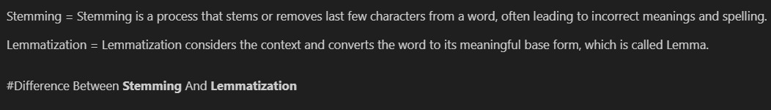
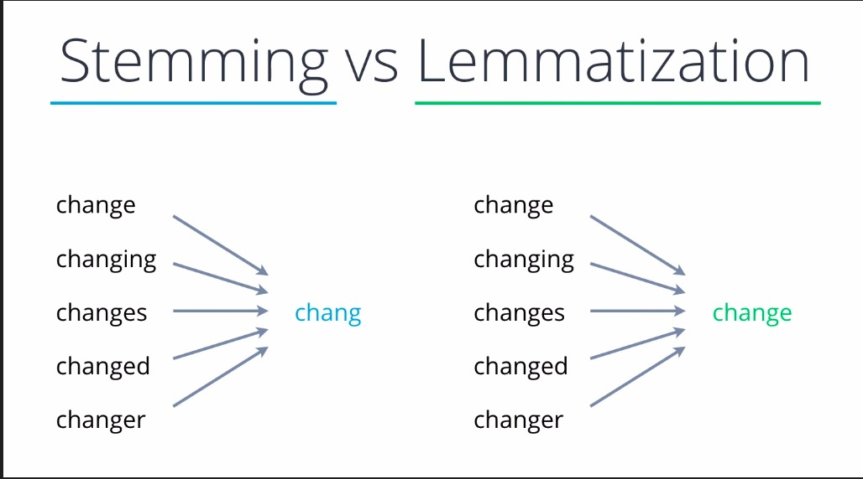
COMPRESSION BETWEEN STEMMING & LEMMATIZATION

Slide 17
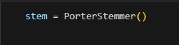
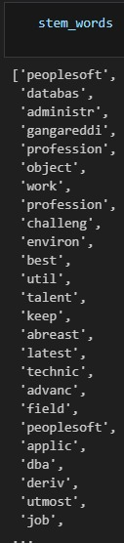
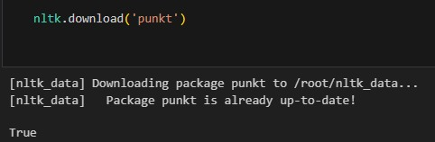
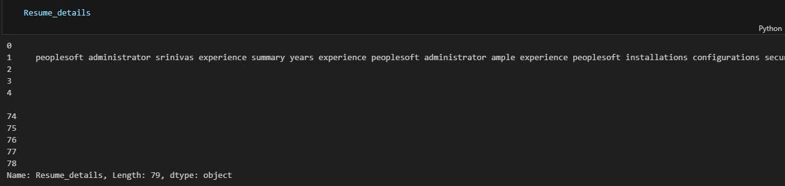
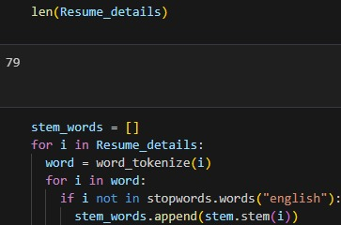
STEMMING

Slide 18
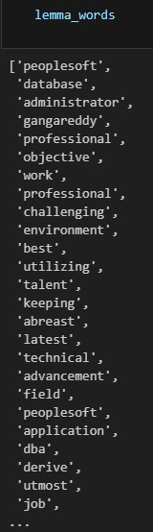
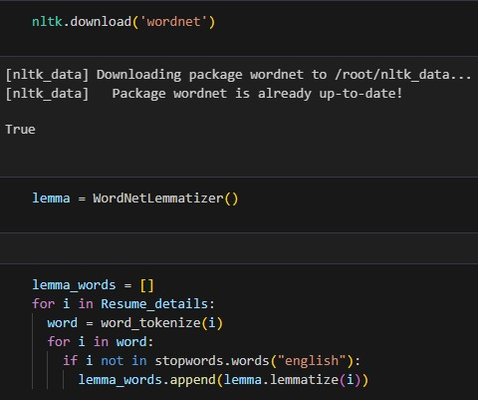
LEMMATIZATION

Slide 19
04
Feature Extraction & Model Building

Slide 20
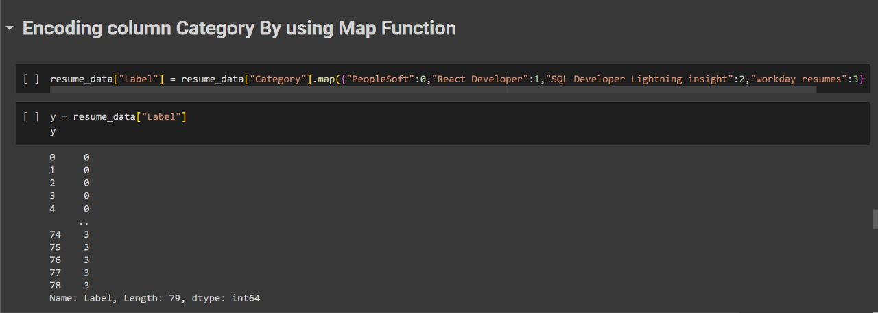
FEATURE EXTRACTION
There are Three Feature Extraction Techniques:
Binary Weight
Bag of Words
TF-IDF

Slide 21
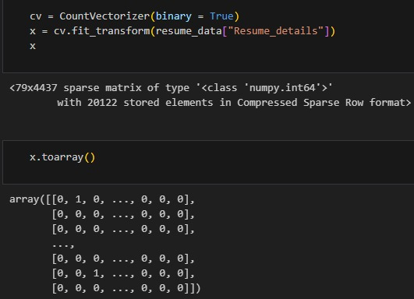
I. BINARY WEIGHT:

Slide 22
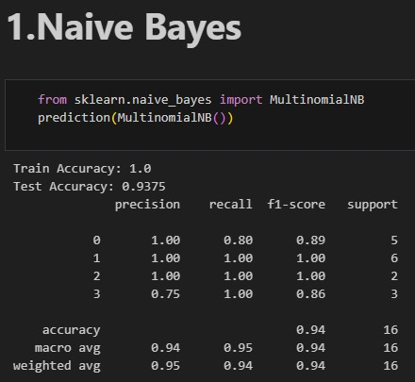
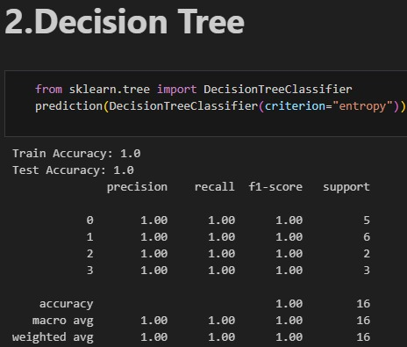
MODEL BUILDING BY USING BINARY WEIGHT

Slide 23
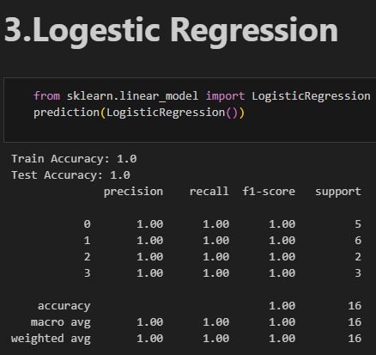
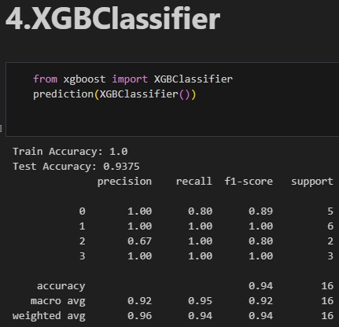
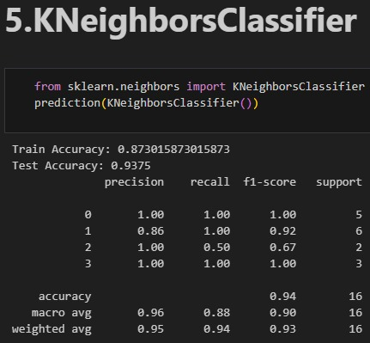
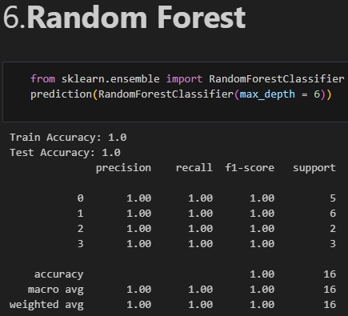

Slide 24
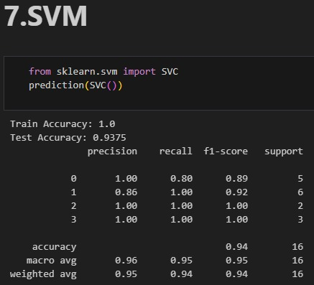

Slide 25
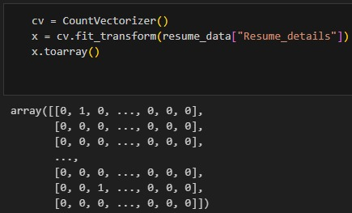
II. BAG OF WORDS:

Slide 26
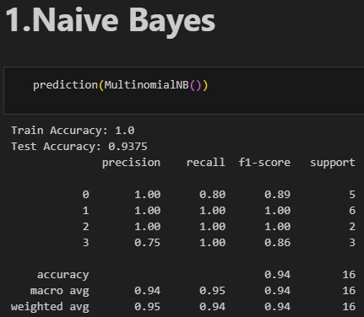
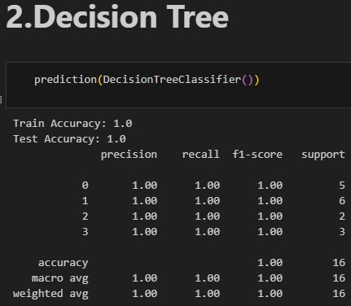
MODEL BUILDING USING BAG OF WORDS

Slide 27
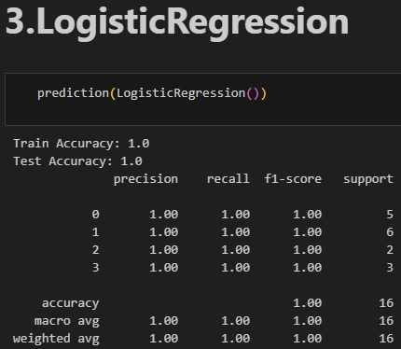
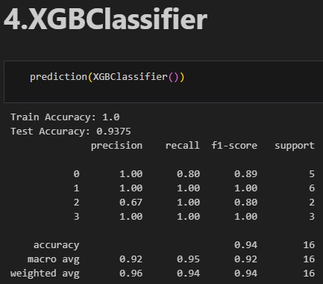
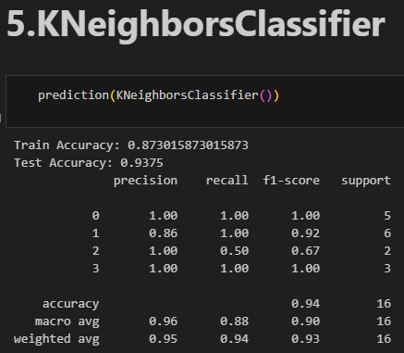
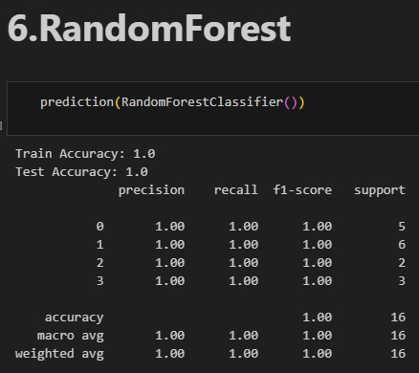

Slide 28
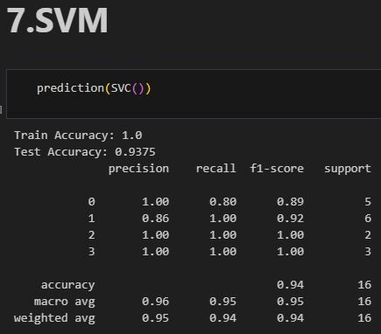

Slide 29
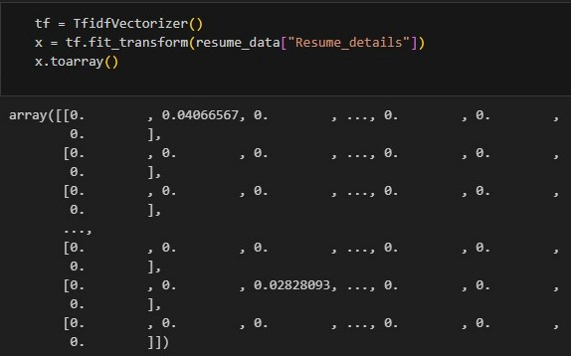
III. TF-IDF:

Slide 30
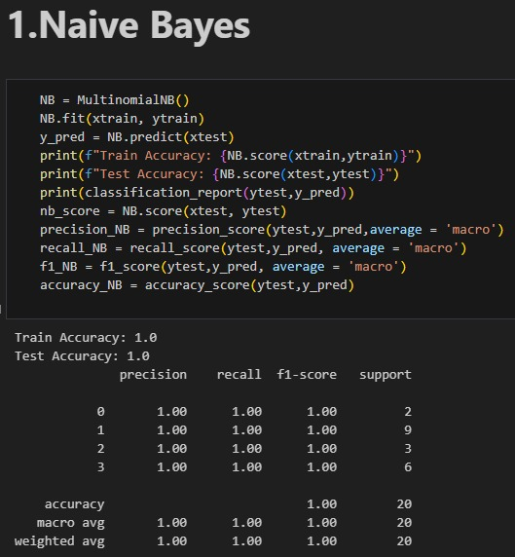
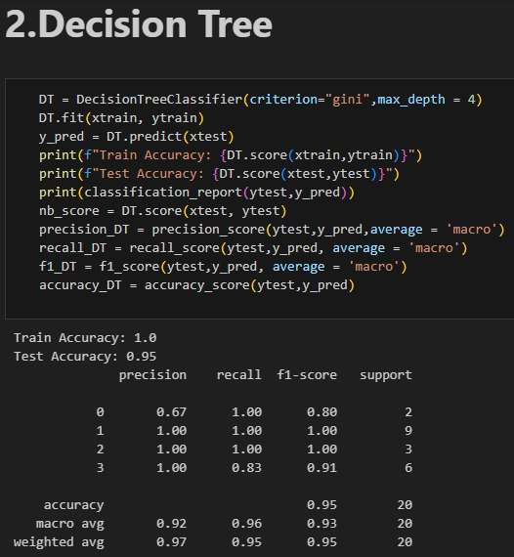
MODEL BUILDING BY USING TF-IDF

Slide 31
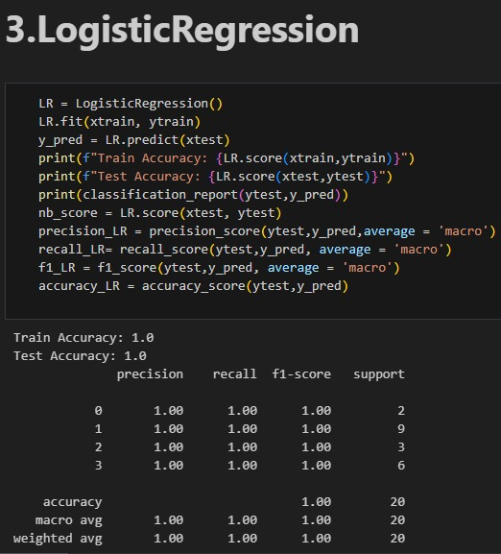
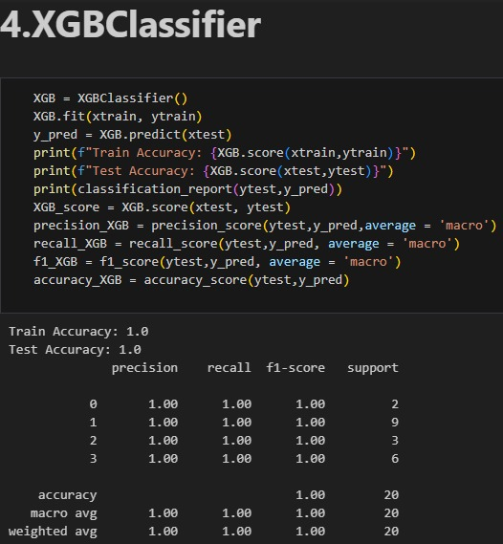
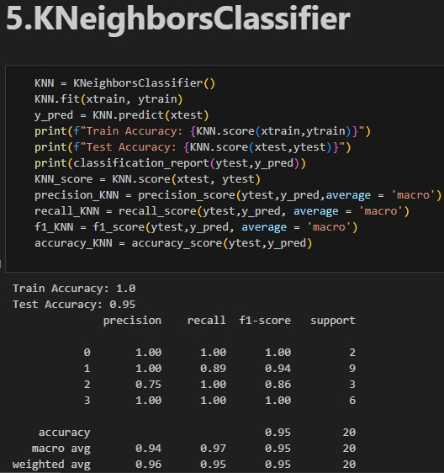
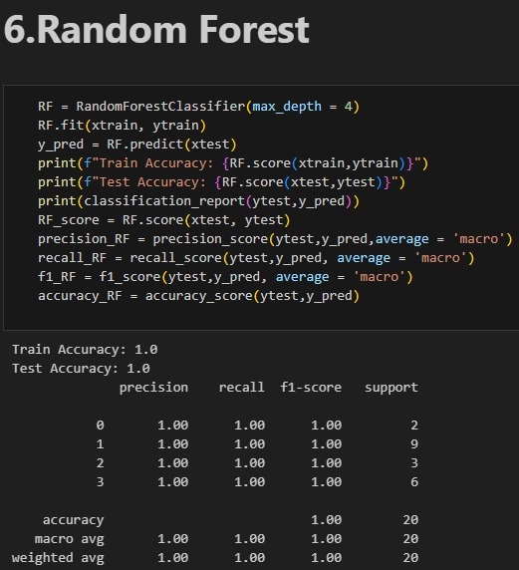

Slide 32
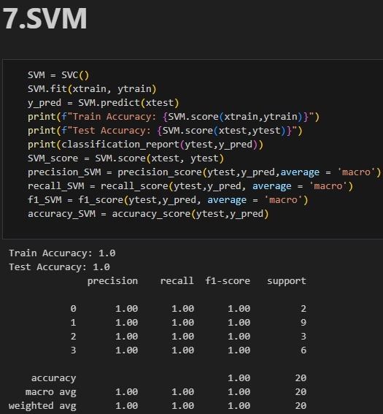

Slide 33
05
Model Evaluation

Slide 34
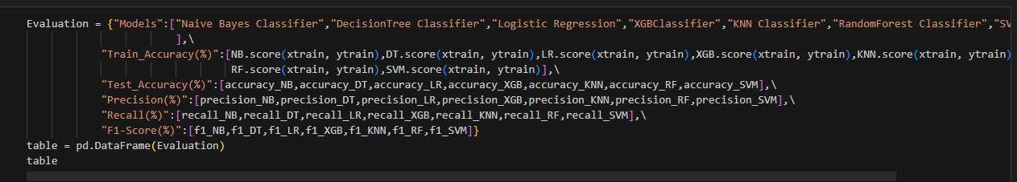
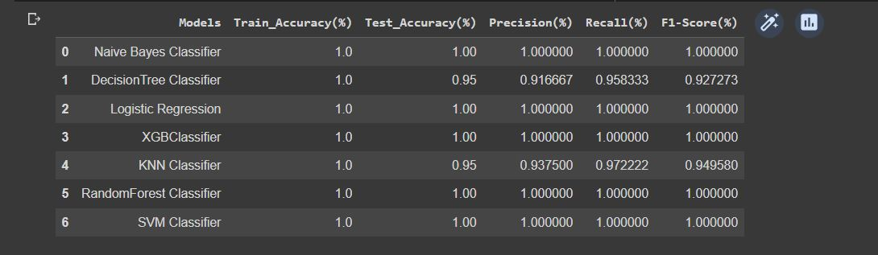

Slide 35


GRAPHICAL REPRESENTATION

Slide 36


FINAL MODEL
Naïve Bayes Model by TF-IDF Feature Extraction Technique:

Slide 37
06
Model Deployment

Slide 38




Anaconda prompt webapp.py
Web app coding
webapp view

Slide 39




UPLOADING RESUME FILES AND GETTING PREDICTION
Upload Resume File:
People Soft File:

Slide 40




React Developer File:
SQL Developer File:

Slide 41


Slide 42
THANK YOU

